Slide 1
GeoSquare Academy
June 12th 2026
Brussels

Slide 2


Kurt Rommens
Head of Public Sector Benelux
Google Cloud
Notes:
A very warm welcome to Google and Google cloud - Hope you were inspired by the massive investment we just announced as the infrastructure is the core to accelerate innovation, Innovation which is needed - I am Kurt Rommens and I am managing the public sector for google cloud for the benelux - as a true belgian, I could not be more proud to see the investments we do, fueling Belgian economy, but there is more, so much more and this is what I will share with you today. I want to run over our contributions and our value we can create for you and your business and show you that - if we all work together and embrace the distruptiive digital transformation we are experiencing, we can and must all benefit from it

Slide 3

We’ve been making the impossible achievable for more than two decades.
Notes:
That very mission is built on a history of making the impossible, achievable.
But at Google, we don't just solve hard computer science problems in a lab. We turn them into helpful products that billions of people use every day — from indexing the web to mapping the physical world.
Now, through Google Cloud, we are handing that same innovation engine to you.
We want to help you tackle your industry's impossible challenges, turning your AI ambition into the kinds of tangible solutions that define market leaders.

Slide 4

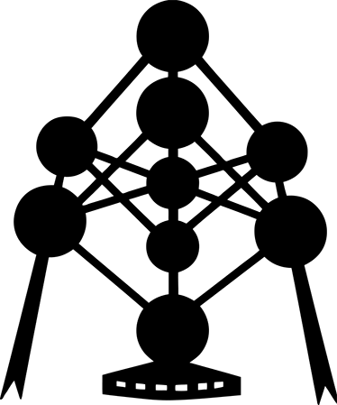
Google in Belgium
Google has invested strategically in Belgium:
Overall, Google has already invested €11 Bn in Belgium
We will have 900 employees working in Belgium (data centers + offices),
YouTube's creative ecosystem contributed €39 M to the Belgian Gross Domestic Product (2020 data) and to the equivalent of 2600 full time jobs in Belgium (2020 data)
Google connects local Belgian SMEs to several billion potential customers
Google has trained 140.000 professionals in the Digital Atelier in BeCentral, on top of Central station in Brussels
With the programs of the Google Digital Atelier, we train Belgian jobseekers to find a job in digital marketing (through partnership with public employment agencies) and we support a diverse startup system in Belgium.
Google books : we've scanned almost 500.000 valuable books in partnership with libraries in Gent, Antwerpen, Leuven and Brussels
Contribution to sustainability in Belgium (we've invested in one of the biggest solar farm and offshore windmills in the North Sea) and diversity (see study in partnership with BCG)
7th datacenter
Since 2007
Invested
€11 Billion
Skills Training
+140.000 ppl
Employees
+900 ppl
Google Books
4 Major Cities
YouTube (‘20)
GDP +€39m
Brave,
Bold,
BeLux

Slide 5
From wait and see…
AI
To driving impact.
We are entering a new era of
Notes:
Looking at where we’re at today, we’ve entered a whole new era of AI [CLICK]
We are moving away from the phase of 'wait and see' — where it was all about pilots and prototypes… [CLICK]
and into the era of driving impact.

Slide 6

AI is now the
driving the global economy
central force
$4.4
trillion
estimated annual productivity growth potential from AI¹
40%
of enterprise apps will feature task-specific AI agents by the end of 2026²
52%
of organizations have already deployed agents in production³
1. McKinsey, Jan 2025 2. Gartner, August 2025 3. Google Cloud, Nov 2025
Notes:
When you zoom out, the scope of that change is undeniable. We are watching a $4.4 trillion shift happen in real time.
Gartner says that by the end of this year, 40% of enterprise apps will feature AI agents. That is a massive jump.
And Google’s own data shows that over half of organizations — 52% — have already deployed agents.
Stat sources:
1. McKinsey, Jan 2025
2. Gartner, August 2025
3. Google Cloud, Nov 2025

Slide 7
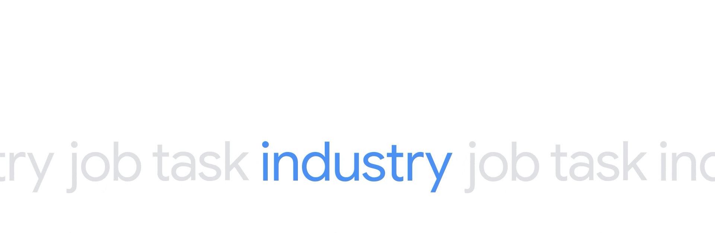

Agentic AI is
reshaping every

Slide 8


The best of Google AI for every employee,
for every workflow
Notes:
And today, we are taking the next step in bringing Google AI to every employee and every workflow.
Gemini Enterprise is now the end-to-end system for the Agentic Era—the connective tissue between your data, your people, and your goals.
It transforms disconnected processes into a single, intelligent flow.

Slide 9










Intelligence
Automation
Agentic Enterprise
Blueprint
Value
Notes:
This is our blueprint for the Agentic Enterprise. It’s also the answer to a fundamental equation:
Intelligence + Automation = Value
To make this work, you need context and action.

Slide 10

Google Cloud is the only provider to offer first-party solutions across the entire AI stack.
the only provider
Notes:
Option 1: Shorter talk track
TPU - 8th generation already!
To help our customers achieve these outcomes, we provide a complete architecture spanning six critical layers — from the chips and infrastructure up to the models and agents.
Google Cloud is the only provider that researches, engineers, and deploys every layer of the stack entirely in-house. We don't just own the components; we co-design them to work as one system.
That deep integration is your engineering advantage. It allows you to deliver differentiated gen AI experiences with velocity, precision, and cost-efficiency at scale — all on a foundation of uncompromising security.
Option 2: Full talk track if you’re just using this slide - goes from the bottom up
Google Cloud is the only provider that researches, engineers, and deploys every layer of the stack entirely in-house. This includes:
AI Hypercomputer, a purpose-built infrastructure foundation optimized for the physics and scale of the Agentic Era.
This foundation supports our research & models. You get world-class intelligence from Google DeepMind, and uncompromising choice across Google's frontier models — like Gemini 3.1 — alongside the best open and third-party options.
Next is the Agentic Data Cloud. This is the engine that grounds your AI in truth, providing agents with trusted, real-time business context.
And with Agentic Defense, you have autonomous, zero-trust protection that secures your entire AI lifecycle from code to cloud.
Near the top is our Agent Platform (evolution of Vertex AI). This is a comprehensive system to build, deploy, and manage agents with architectural rigor.
Agents and applications: All of these components set you up to orchestrate an Agentic Taskforce. You can build your own agents, or purchase pre-built, specialized agents from Google and our trusted Partners that close the gap between strategy and execution to drive tangible ROI. You can govern, secure, observe, and deploy those agents through our agentic surfaces and solutions which we’ll dive into shortly.
Crucially, we don't just own the components; we co-design them to work as an integrated system. This ultimately helps customers ship differentiated experiences with velocity, precision, cost-efficiency, and security at scale.

Slide 11





Belgium's AI Opportunity
MACROECONOMIC POTENTIAL
+9% GDP Boost (+€45-50B)
Widespread adoption over 10 years transforms the economy, augmenting 64% of jobs and injecting direct productivity gains.
EGOVERNMENT STRATEGY
+10% Public Sector Efficiency
Automating cross-cutting tasks like case handling yields €4B in annual value and trims €0.8B in administrative corporate drag.
DIGITAL INNOVATION
100,000+ High-Value Jobs
Nurturing and scaling innovative digital businesses to peer levels contributes up to €17B annually to private sector growth.
Source: Implement Consulting Group Reports (Commissioned by Google)

Slide 12



With new opportunities
come new challenges
We all care about:
Turning AI experimentation into measurable outcomes
Preparing for tomorrow without jeopardizing what works today
Mitigating risk, especially in regulated environments
Notes:
But while the opportunity is tremendous, the path to value isn't always a straight line. It creates a set of new realities that every leader has to navigate.
Regardless of where you are in that journey, three things are likely top of mind:
First, turning experimentation into measurable outcomes. The focus has shifted from “what is possible” to “what creates value.” The pressure is on to move past pilots and demonstrate real business impact.
Second, preparing for tomorrow without jeopardizing today. Organizations need to modernize and layer in innovation, without disrupting the systems that are already working well.
And third, mitigating risk. It’s not just about security; it’s about trust. As you scale AI, you need to ensure your models are safe, compliant, and governed — so you can innovate without putting your brand or data at risk.

Slide 13



Sovereignty has never been more important
Image / gif
“By 2030, more than
75%
of all enterprises outside of the U.S. will have a digital sovereignty strategy.”
Google Cloud
Source: Gartner Press Release, Gartner Survey Reveals Geopolitics Will Drive 61% of CIOs and IT Leaders in Western Europe to Increase Reliance on Local Cloud Providers, November 12, 2025. GARTNER is a trademark of Gartner, Inc. and/or its affiliates.
Proprietary & Confidential
Notes:
A recent Gartner study found that by 2030, more than 75% of all enterprises outside of the U.S. will have a digital sovereignty strategy. Are you ready for it?

Slide 14




Innovation or compliance: Why choose?
Image / icon
Regulatory challenges
Geopolitical changes
Faster innovation
sources
Notes:
Sovereignty & compliance has become a mainstream requirement.
With this, we’re seeing many organizations struggle with the choice between innovation and compliance. This has led to a surge in need for sovereign solutions, being driven by:
Increased regulations & operational independence: Rise of data protection laws causes the need for more digital and physical control over organizational data access and operations.
Need for geopolitical and system resilience: Organizations in highly regulated sectors must prepare for changing dynamics and need to plan for new scenarios to ensure that their data and operations are resilient. Dynamics like local computing power and jurisdictional protection are just a couple of examples.
Drive for faster innovation including AI: Developing these capabilities in-house can be time-consuming, expensive and can divert resources that could have been used for modernization or innovation. External pressures are forcing organizations to innovate and transform much faster, especially for the emerging AI and generative AI initiatives.
Sovereign solutions can provide a faster way to achieve these goals.

Slide 15


Sovereignty concerns originate from different concerns.
What do we engineer for today?
Root causes of increasing digital sovereignty requirements
The data discussion
Where is my data/service?
Who can access my data?
How do I prevent access?
Do I have ultimate control?
Technology distribution
How to mitigate effects of the uneven distribution of technology across the world?
Global disruption
How to have AI in close control? How to prepare for a “kill-switch” event? How to innovate on-prem?

Slide 16

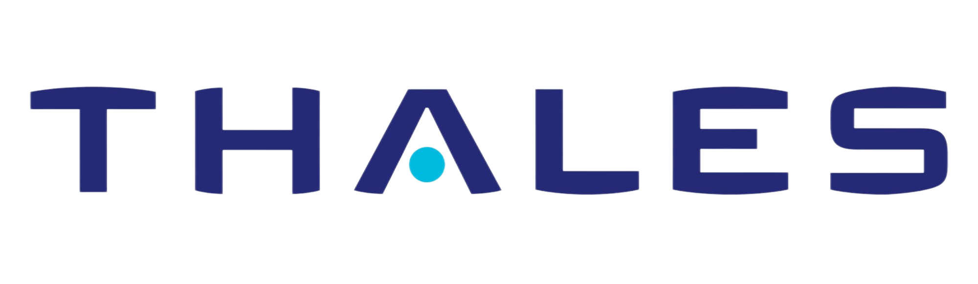
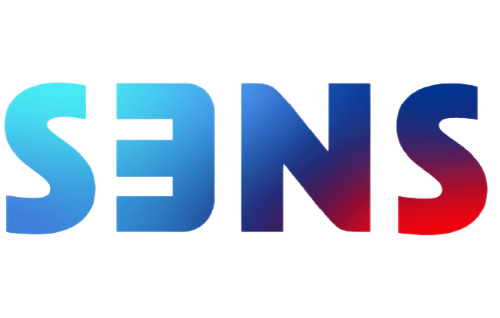
Sovereign Cloud from Google proposes the power of choice
A continuum of options to address each local requirement now and in the future
Sovereign Cloud from Google
Google Cloud
Data Boundary
Google Cloud
Dedicated
Google Distributed
Cloud
Suplementary software controls over Public Cloud regions to assure for residency, transparency & access control.
Twin universe of Google Cloud handed over to independent domestic cloud service provider.
On-premises deployment: Connected or Air-gapped. Advanced infra, built for AI, state of the art security, Open Ecosystem.

Slide 17


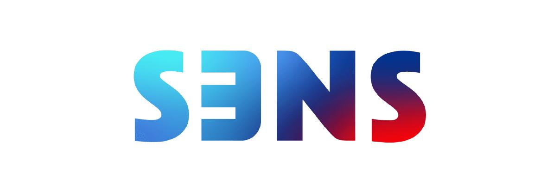

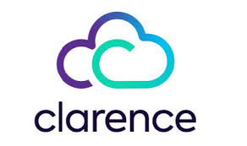






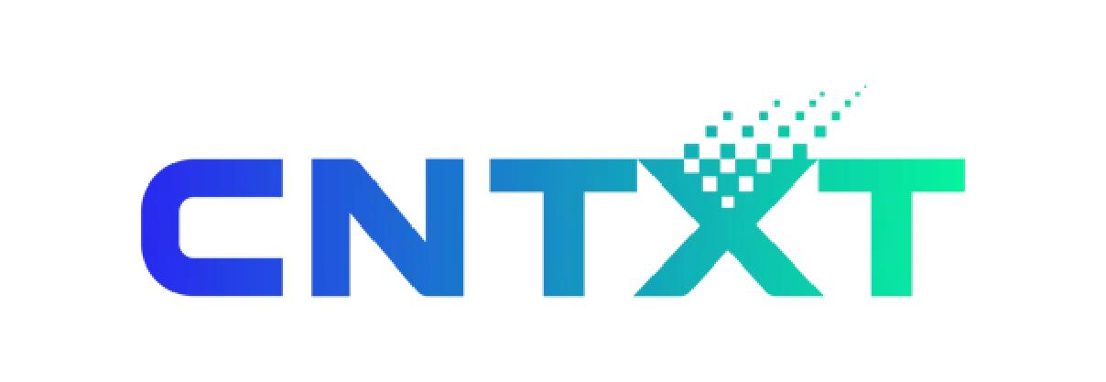
Sovereignty of choice
Building “with” Europe, not “for” Europe
Root causes of increasing digital sovereignty requirements
Germany
France
UK
Luxembourg
Armed Forces
France
Spain
Germany
NATO
Germany
Italy
Saudi Arabia

