Slide 1


ORBIS MAPS & TRAFFIC
RESILIENT INFRASTRUCTURE
JC

Slide 2


MAPPING UNDER PRESSURE
in a rapidly changing world
URBAN COMPLEXITY
Post-Covid cities introduce complex mobility constraints: LEZ / ZEZ / ZTL, truck bans, bike-streets, HOV, “knips”, car ban …
creating high-frequency change detection requirements.
DATA EXPLOSION
Massive availability of open, commercial, and imagery sources. Qualitative conflation at global scale is a critical costly challenge.
Duplicated efforts by many actors, AI analysis & UI
UBERIFICATION
E-commerce, food delivery, fleets, rideshare drives demand for
Route & ETA optimization and Stable IDs across freq updates
GeoINT decisions (insurance, geomarketing, depot locations)
→ much higher need for complex restr data, conflation, faster updates and
consistent global coverage far beyond traditional cartography

Slide 3






THE MILITARY TO COMMODITY SHIFT
detailed maps widely accessible, but …
DATA SOURCES SHIFT
CORP. INVESTMENT
NEW THREAT VECTORS
Transition from institutional high-expertise proprietary sources to
- active volunteer-sourced,
- passive probe and social signals.
Large investment (upd & SOTM)
in OSM by tech corporations
Geopolitical tensions (UKR IRN ISR …) increase
- fake spatial data,
- OSM vandalism and
- supplier censoring/embargoing.
→ pure reliance on US & Open providers creates systemic risk
Strong push for EUR resilience/autonomy, expertise and interoperability

Slide 4
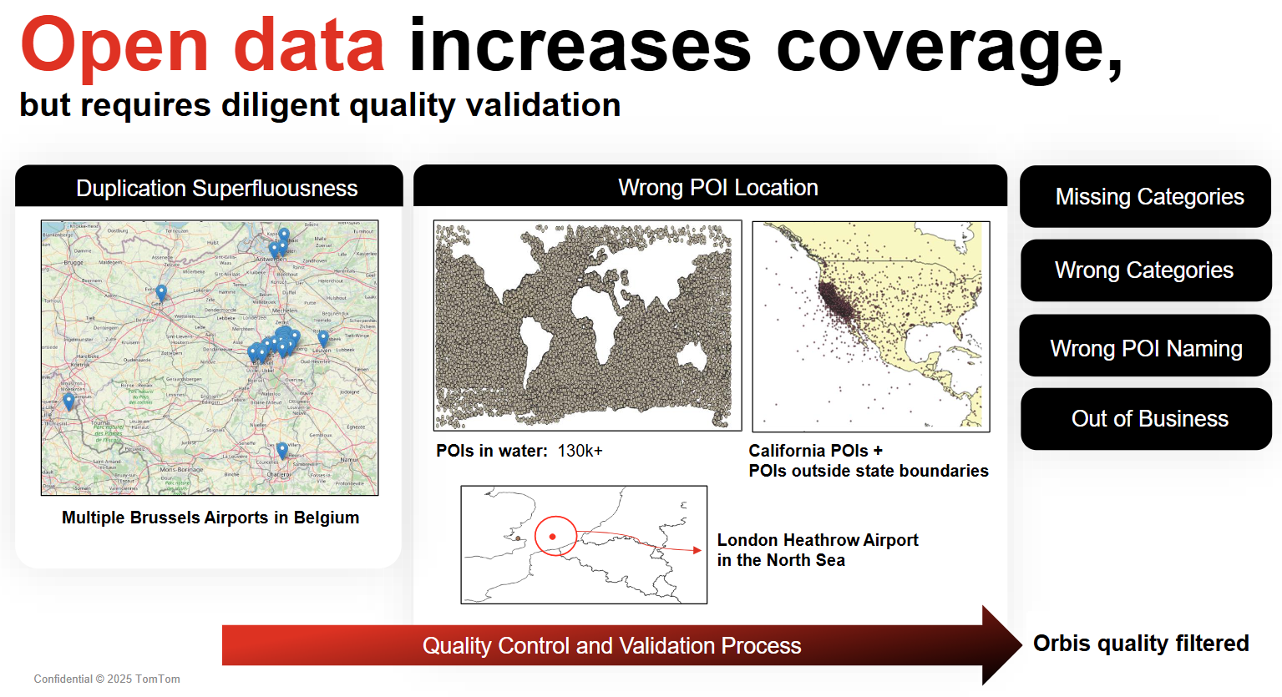

Slide 5
RESILIENCE & PUBLIC SECTOR IMPACT

Slide 6
GEOSPATIAL CAPABILITY: RESILIENCE
building a more resilient public sector
Critical Resources Continuity Prepare, Study, Train, Defend, Resist, Recover.
Essential for energy, food, healthcare, transport, finance and R&D sectors.
Climate Impact Management floods, wildfires, storm events
Managing evacuations & refugee flows, deploying & tracking of emergency assets
Defense & Disaster Management EU Military Mobility "MIL Superhighway", ref layers for SAT/AIR/UAV imagery and damage assessment (houses, agriculture, school/hospital/energy infrastructure, industrial buildings).
→ GeoSpatial intelligence is the backbone of effective resilience, locating risk zones, available roads, bottlenecks, alternative routes …

Slide 7

A SOVEREIGN EUR
GEO PLATFORM
Combines open and proprietary data sources.
Operated by EU-owned specialists with decades experience.
High-precision automation & vandal protection using AI
Open standards & StableIDs
to persist private data across updates
Global coverage with near-real-time impact (edit/deliver).
Supports preparation & recovery through
historic & live traffic insights
→ Maps are no longer just navigation tools, it is strategic resilience infra
enabling security, mobility, economic continuity & crisis response
ensuring trusted sovereign interoperable fresh geospatial data

Slide 8
TECHNICAL FOUNDATIONS & ENABLERS

Slide 9
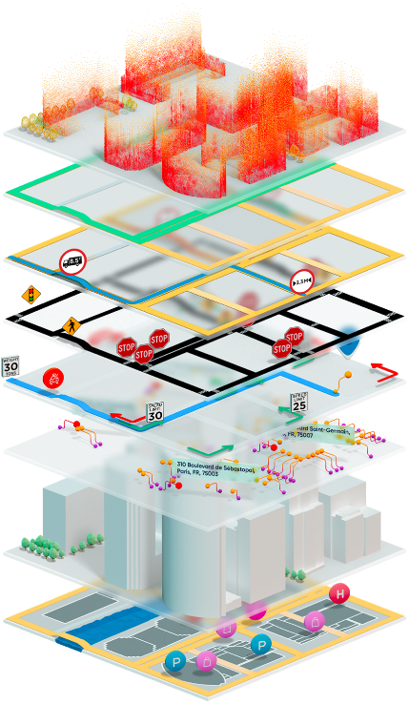
ORBIS MAP
Technical foundations
ENABLERS & GOVERNANCE
Stable GERS IDs enabling private data links across updates Feature/Country separation for ODBL alignment
Standard formats PBF, FGDB, OGP (GeoParquet)
AI
MCP server for APIs (search,route,traffic,analytics)
Enabling map/traffic-aware & voice-based agentic workflows
ML pipelines, NavAI (TAIA), Assistants & DEV (Kapa,Chatty,CoPilot)
REPRESENTATIVE BIGTECH USERS
TT-APP, NGA, EAS, MSF, KAP, PTV, THT …

Slide 10
QUESTIONS?
Building a Resilient Geospatial Future Together
JC
tomtom.com

Slide 11
