Slide 1
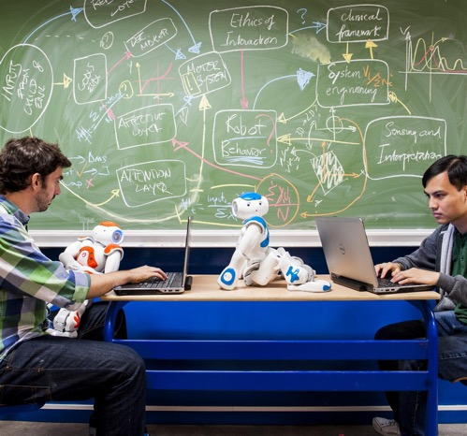


Optimising geospatial epidemic policies with reinforcement learning
prof. dr. Pieter Libin
ai.vub.ac.be
Pieter Libin
Notes:
30min (plus 5min for questions)

Slide 2
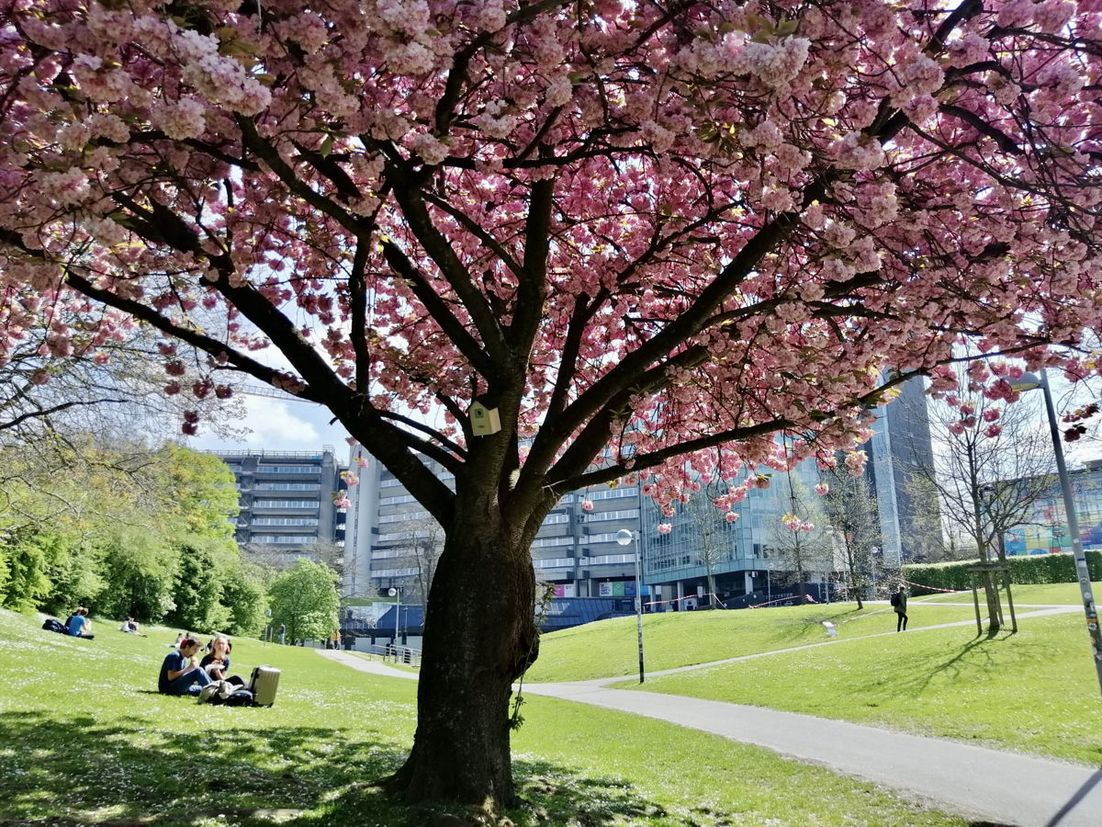





Introduction
INtroduction
Pieter.Libin@vub.be
@PieterLibin
Assistant Professor (AI lab, VUB)
Research: decision making using realistic models and reinforcement learning
ai.vub.ac.be
@aibrussels

Slide 3
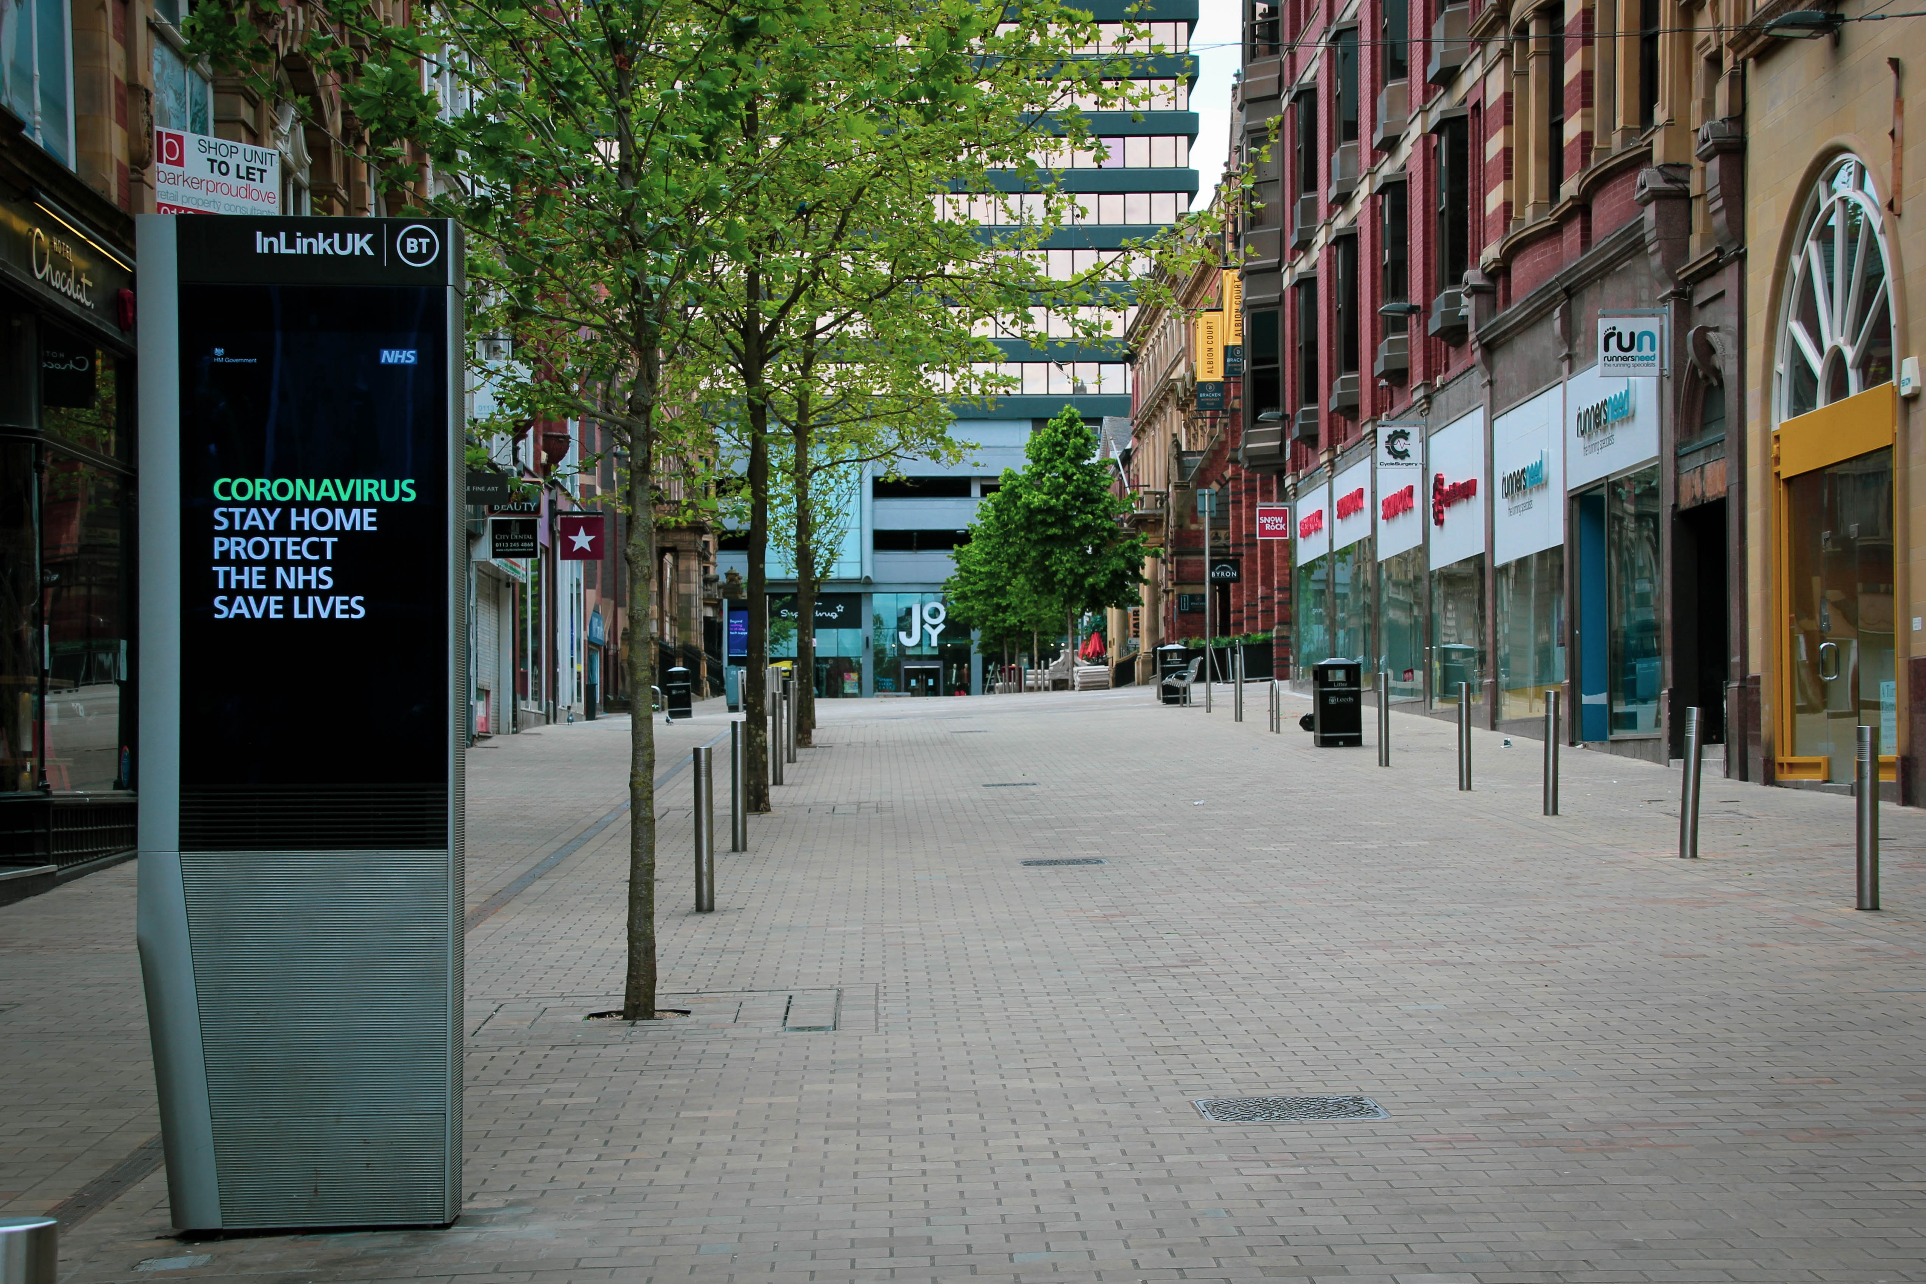
Source: Unsplash
Notes:
COVID/Ebola(2014), huge medical burden -> hard measures are necessary.
E.g. lockdown, discuss burden

Slide 4

Source: Unsplash
Notes:
Closing schools, discuss burden on children and adults

Slide 5
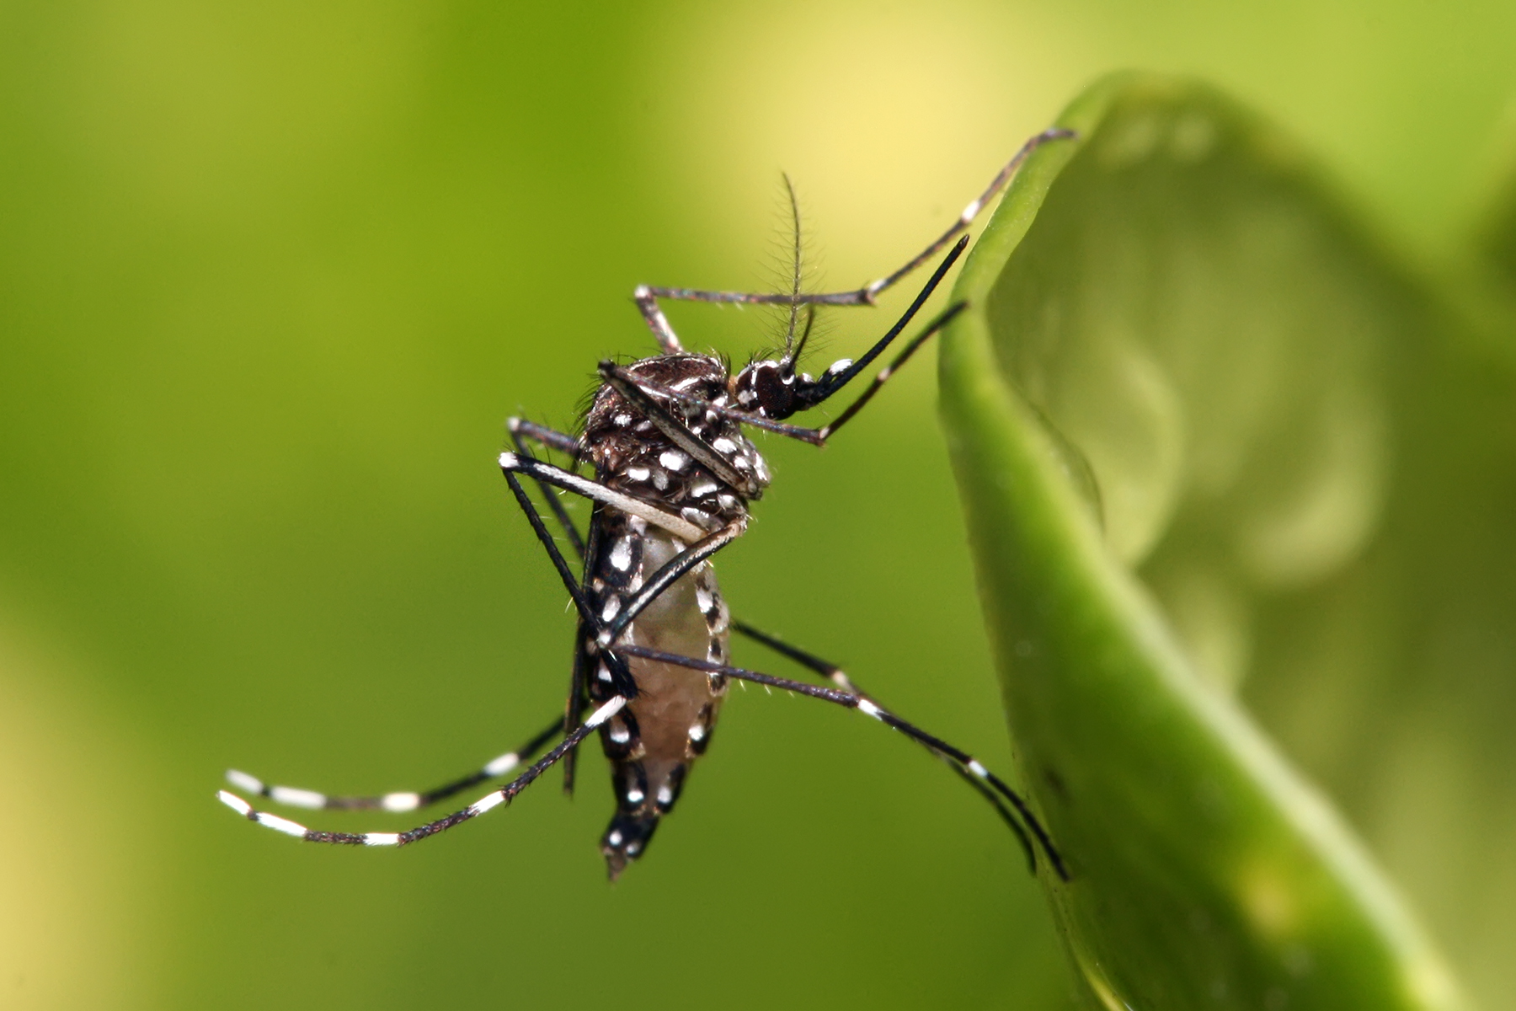
Source: Unsplash
Notes:
Closing schools, discuss burden on children and adults

Slide 6
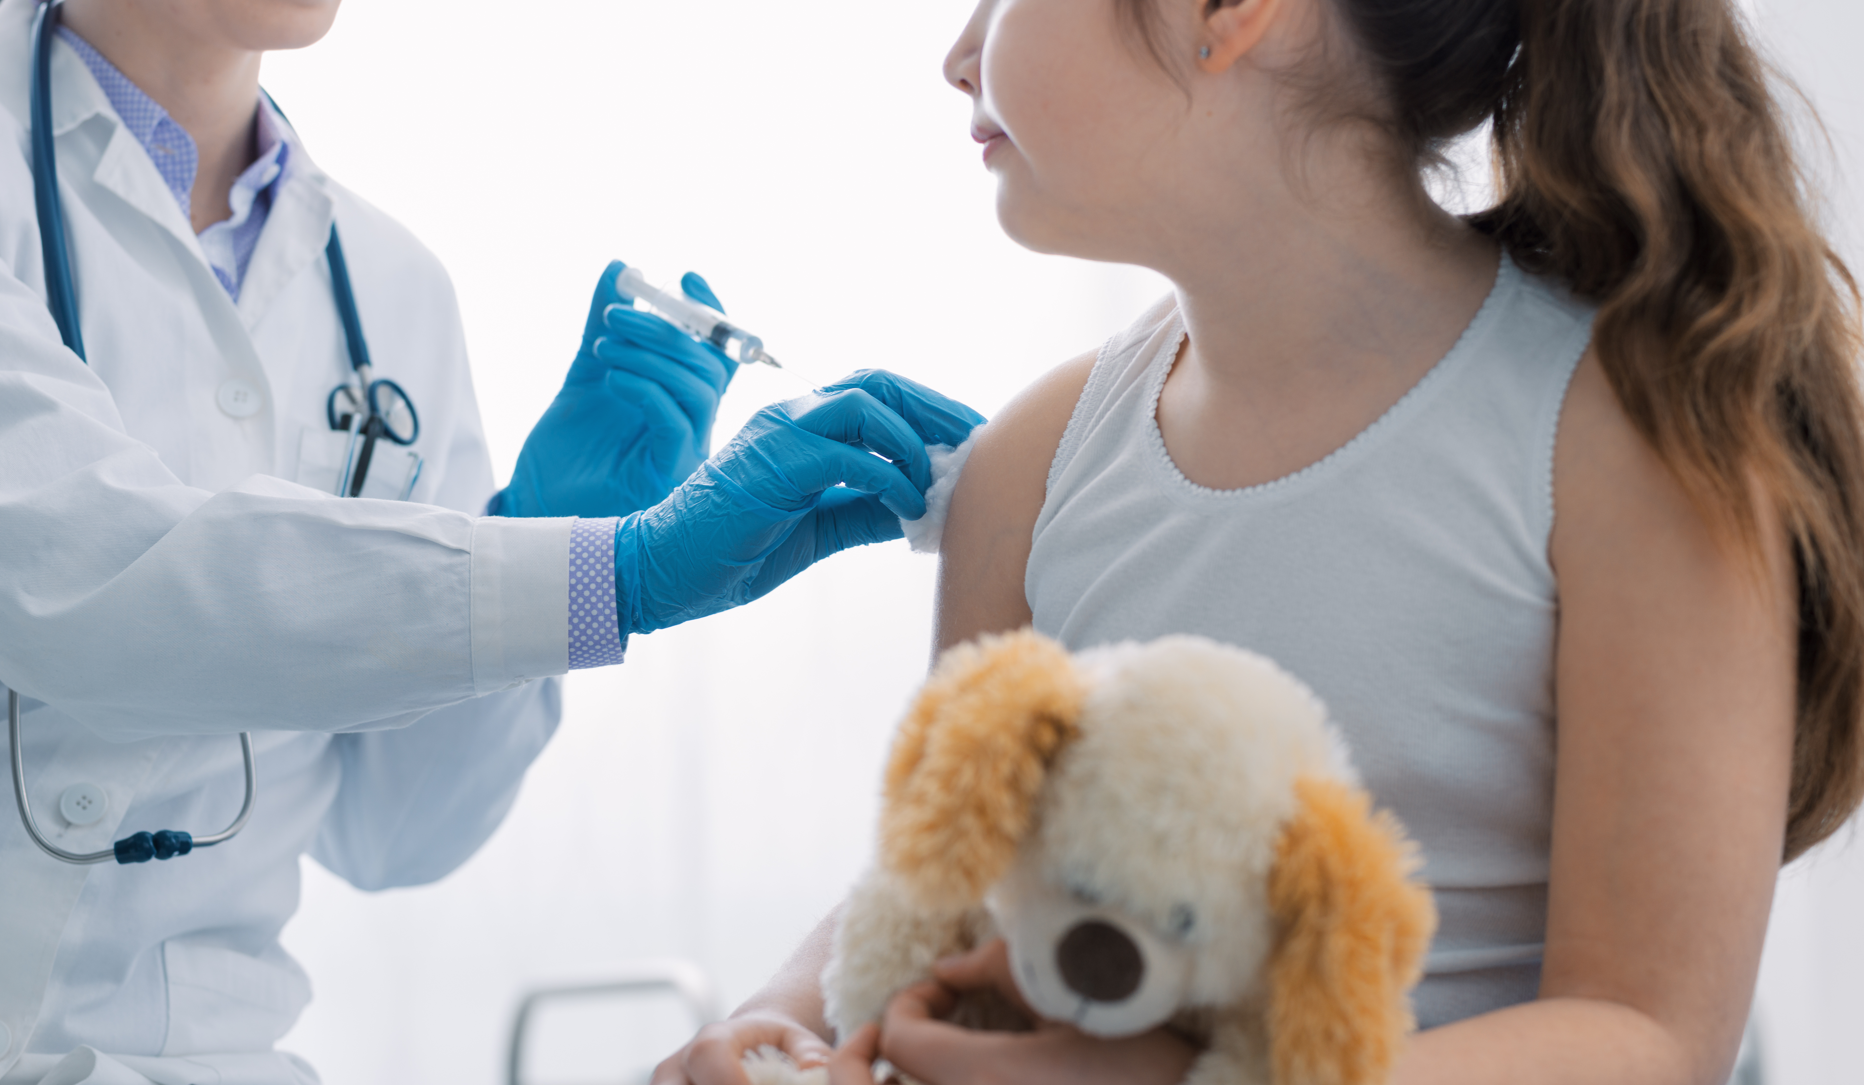
Source: Unsplash
Notes:
Vaccinating. Very effective, yet not necessarily available.
Need for what we call non-pharmaceutical preventive measures, such as school closures, contact reductions

Slide 7
Epidemiological models
Compartmental models
Notes:
Differential equations
Discuss complexity

Slide 8
Epidemiological models
Compartmental models
Individual-based models
Notes:
Differential equations
Discuss complexity

Slide 9
Epidemiological models
Compartmental models
Individual-based models
Metapop models
Notes:
Even with such models, coming up with optimal strategies is hard.

Slide 10
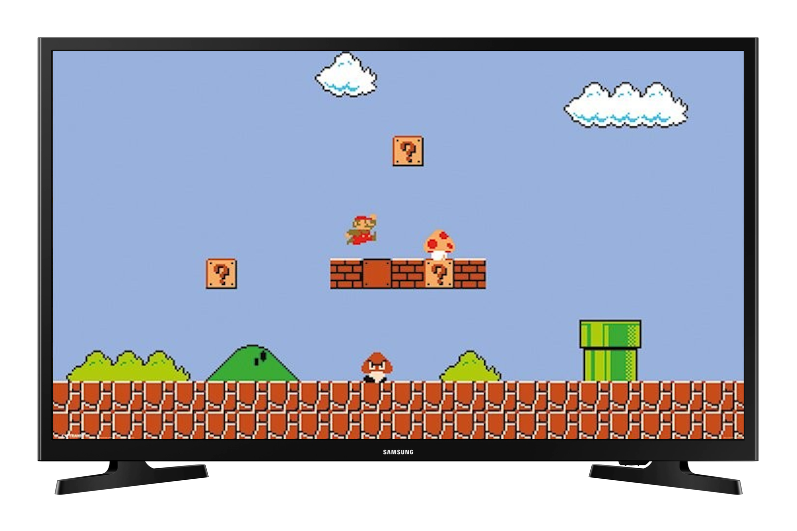

REINFORCEMENT LEARNING (RL)
Environment
Action
State/Reward
Agent
Notes:
RL -> machine learning
Demonstrate it according to this video game
Show each component: env -> agent -> action -> state/reward
Trial error: like riding a bike

Slide 11

DEEP REINFORCEMENT LEARNING
Notes:
Large state space -> screens
To generalize and make learning possible: DNN + RL

Slide 12
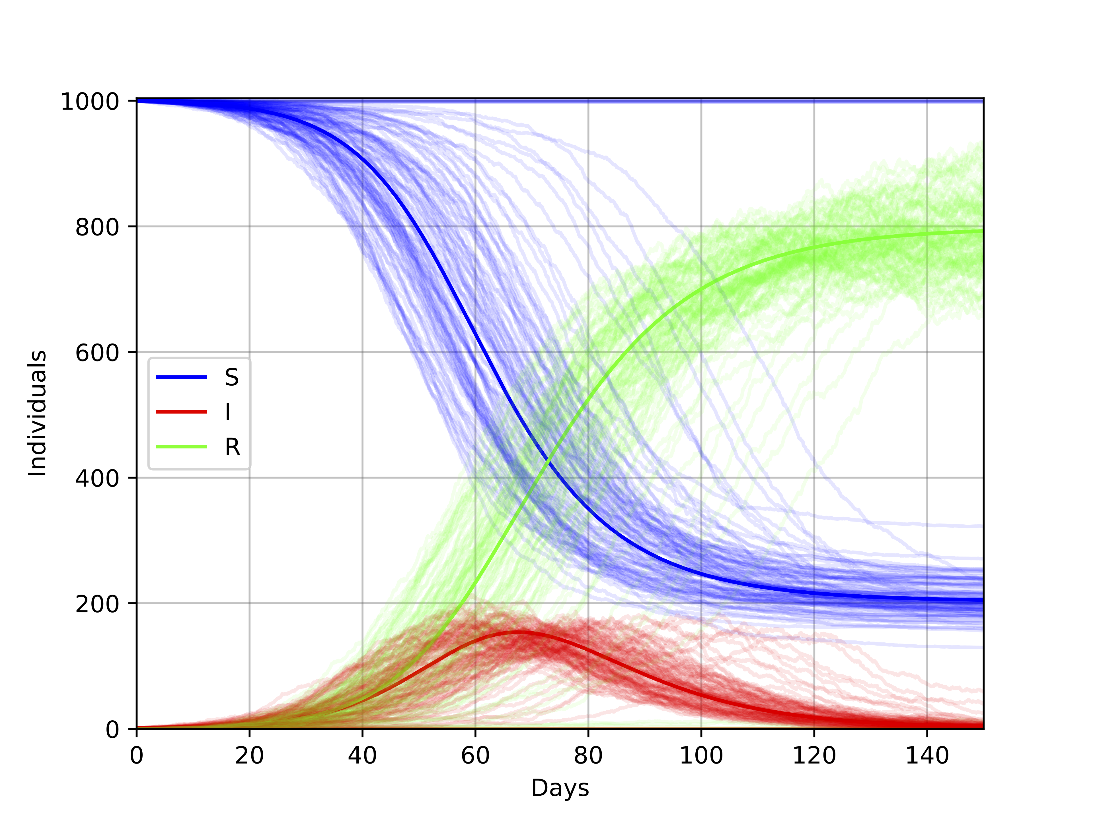
RL TO migitate epidemics

Slide 13


Introduction
SCHOOL CLOSURE POLICIES - META-POPULATION MODEL

Slide 14
RL TO COORDINATE SCHOOL CLOSURES
Notes:
School closures
Computational concerns -> metapop model

Slide 15
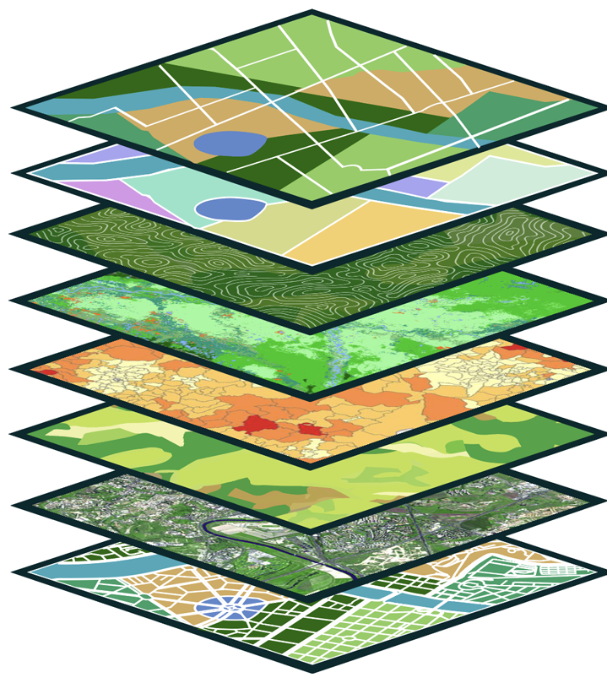










RL TO COORDINATE ARBOVIRUS SCREENING anD MITIGATION
$$H_{a}$$
Human
$$I_{a}^{S}$$
$$S_{a}$$
$$E_{a}$$
$$R_{a}$$
$$I_{a}^{A}$$
Mosquito
$$S$$
$$E$$
$$I$$
Notes:
School closures
Computational concerns -> metapop model

Slide 16

RL TO COORDINATE ARBOVIRUS SCREENING anD MITIGATION
Notes:
School closures
Computational concerns -> metapop model

Slide 17

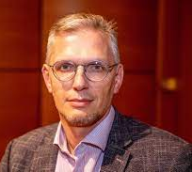
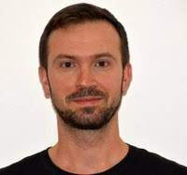
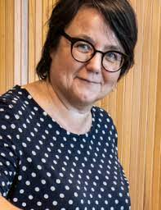




ACKNOWLEDGMENTS
Ann Nowe
Andrea Torneri
Niel Hens
Philippe Lemey
Notes:
Multi-discp project

Slide 18
Thank you! Any more questions?
THANK YOU! ANY QUESTIONS?
ai.vub.ac.be
Pieter.Libin@vub.be
Pieter Libin

Slide 19
GRAPHIC CREDITS
Cats/dogs/crackers/drugs/ICU/bike/robot/LHC/beer/westvleteren/Las Vegas: unsplash
Mouse/mouse trap/Atari/Bayes/Mosquito: Wikipedia
Cheese: Kaasdok.nl
Go board game: https://www.go-jigs.eu/what-is-go/
Lee Sedol: New Yorker
Clinical trials: https://www.cbinsights.com/
Telecom application: Ericson website
ICU covid: sciensano
Value functions in super mario: Gemini

Slide 20
Thank you! Any more questions?
REFERENCES
Libin, Pieter JK, et al. "Deep reinforcement learning for large-scale epidemic control." Machine Learning and Knowledge Discovery in Databases., ECML PKDD 2020, Ghent, Belgium.

